Slide 1



ANALYSIS OF
CONTENT CATAGORIES
PRESENTED BY: DEV SHARMA
LAST UPDATED: 30-07-2024

Slide 2


AGENDA
Project recap
Problem
The Analytics team
Process
Insights
Summary

Slide 3

Social Buzz is a very popular social media & content creation platform
Tasks for 3-month initial project to provide them:
-An audit of their big data practice
-recommendations for a successful IPO
- An analysis of their top 5 content categories.
Project Recap

Slide 4

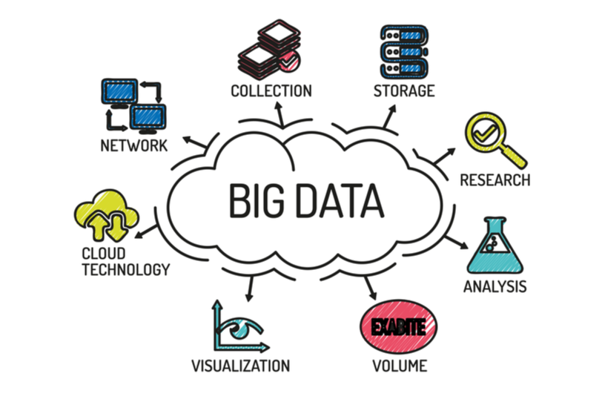
Problems
Everyday 100,000 posts
500 million active users
Big and unfiltered data
Data cleaning and merging

Slide 5



ANDREW FLEMING
CHIEF TECHNICAAL ARCHITECT
The Analytics team
MARCUS ROMPTON
SENIOR PRINCIPLE
DEV SHARMA
DATA ANALYST

Slide 6
Process
1 Understanding the problem
2 Data cleaning and merging
3 Data Visualization
4 Analysis
5 Presentation

Slide 7

Insights
Following are some key findings from analysis:
Animals content category is most popular among all 16 categories
There are total 1738 reactions on Animal category content
Maximum number of content were posted in January month

Slide 10

Social buzz can invest more resources in top categories(Animal & Science) as they got max reactions.
Food related posts are quite popular are there are 2 categories related to food in top 5. hence More budget can be allotted to content creators in these categories
Technology related content also have great scope
Summary

Slide 11

Thank you!
ANY QUESTIONS?

